Slide 1

Decision-Making Frameworks
Decision Support Systems
Kağan OKATAN, PhD

Slide 2
Types of Decisions: Structured vs. Semi-Structured vs. Unstructured
Structured Decisions
Characteristics:
Well-defined problems with clear criteria
Established procedures and rules
Quantifiable outcomes
Routine and repetitive nature
Limited alternatives with predictable consequences
Examples:
Inventory reordering (when stock hits reorder point)
Credit approval based on credit scores
Employee overtime calculations
Standard pricing decisions

Slide 3

Semi-Structured Decisions
Characteristics:
Partially defined problems
Some established procedures, but require judgment
Mix of quantitative and qualitative factors
Moderate uncertainty
Combination of routine and novel elements
Examples:
Budget allocation across departments
Performance evaluation and promotion decisions
Vendor selection with multiple criteria
Project resource allocation

Slide 4

Unstructured Decisions
Characteristics:
Poorly defined or novel problems
No established procedures
High uncertainty and ambiguity
Require creativity and intuition
Significant strategic implications
Examples:
Entering new markets
Responding to crisis situations
Innovation and R&D investments
Organizational restructuring

Slide 5

Simon's Model: Intelligence–Design–Choice–Implementation
Herbert Simon's four-phase decision-making model provides a systematic approach to complex decisions.

Slide 6

Phase 1: Intelligence
Purpose: Problem identification and understanding
Activities:
Environmental scanning
Problem recognition
Information gathering
Situation analysis
Defining the decision context

Slide 7

Phase 2: Design
Purpose: Developing alternative solutions
Activities:
Generating possible alternatives
Identifying constraints and resources
Evaluating feasibility of options
Creating decision criteria
Structuring the problem

Slide 8

Phase 3: Choice
Purpose: Selecting the best alternative
Activities:
Evaluating alternatives against criteria
Analyzing trade-offs
Making the final selection
Justifying the decision
Considering implementation requirements

Slide 9

Phase 4: Implementation
Purpose: Putting the decision into action
Activities:
Planning implementation steps
Allocating resources
Monitoring progress
Making adjustments as needed
Evaluating outcomes

Slide 10
Group Decision-Making and Behavioral Aspects
Group Decision-Making Advantages
Group Decision-Making Disadvantages
Diverse Perspectives: Multiple viewpoints lead to better problem understanding
Increased Information: More knowledge and experience available
Better Acceptance: Participants more likely to support decisions they helped make
Risk Sharing: Shared responsibility for outcomes
Quality Improvement: Critical evaluation reduces errors
Time Consuming: Coordination and discussion take longer
Groupthink: Pressure for consensus may suppress dissent
Dominant Members: Some individuals may overly influence decisions
Social Loafing: Some members may contribute less effort
Compromise Solutions: May lead to suboptimal "middle-ground" decisions

Slide 11
Behavioral Factors in Decision-Making
Individual Biases
Group Dynamics
Confirmation Bias: Seeking information that confirms existing beliefs
Anchoring: Over-relying on first piece of information
Overconfidence: Overestimating one's abilities or accuracy
Loss Aversion: Preferring to avoid losses over acquiring gains
Availability Heuristic: Judging probability by ease of recall
Groupthink: Unanimous but poor decisions due to pressure for harmony
Polarization: Groups making more extreme decisions than individuals
Social Facilitation: Performance changes in presence of others
Conformity: Aligning with group opinion despite personal disagreement

Slide 12

Case Study Analysis
Case Study 1: Restaurant Chain Expansion (Unstructured Decision)
Background: A successful regional restaurant chain with 15 locations is considering national expansion.
The CEO must decide whether to expand, and if so, how quickly and through what method (franchising vs. company-owned stores).

Slide 13
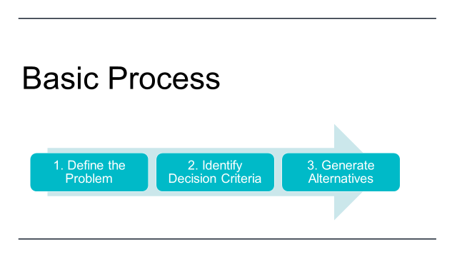

Slide 14
1. Define the Problem
Should the restaurant chain expand nationally?
If yes, what is the optimal expansion method (franchising vs. company-owned)?
At what pace should the expansion occur?

Slide 15

2. Identify Decision Criteria
Key factors to consider:
Financial Resources (capital requirements, cash flow, ROI)
Control & Quality (brand reputation, customer experience consistency)
Growth Speed (how fast can new markets be entered)
Risk Tolerance (market risks, operational risks)
Scalability & Management Capacity
Competitive Landscape

Slide 16
3. Generate Alternatives
No Expansion → Maintain current 15 locations.
Gradual Company-Owned Expansion → Open 2–3 new locations per year, funded internally.
Aggressive Company-Owned Expansion → Rapid rollout in multiple cities, requiring external financing.
Franchising Model → Expand nationally via franchise partnerships, lower upfront capital, shared risk.
Hybrid Model → Open flagship stores in major cities + franchise smaller markets.

Slide 17
4. Evaluate Alternatives
Criteria | No Expansion | Gradual Company-Owned | Aggressive Company-Owned | Franchising | Hybrid
Financial Investment | Low | Medium | High | Low | Medium
Control & Quality | High | High | Medium | Low | Medium
Speed of Growth | None | Slow | Fast | Very Fast | Fast
Risk Level | Low | Medium | Very High | Medium | Medium
Scalability | Low | Medium | High | Very High | High
Profit Potential | Medium | High | Very High | Medium | High

Slide 18
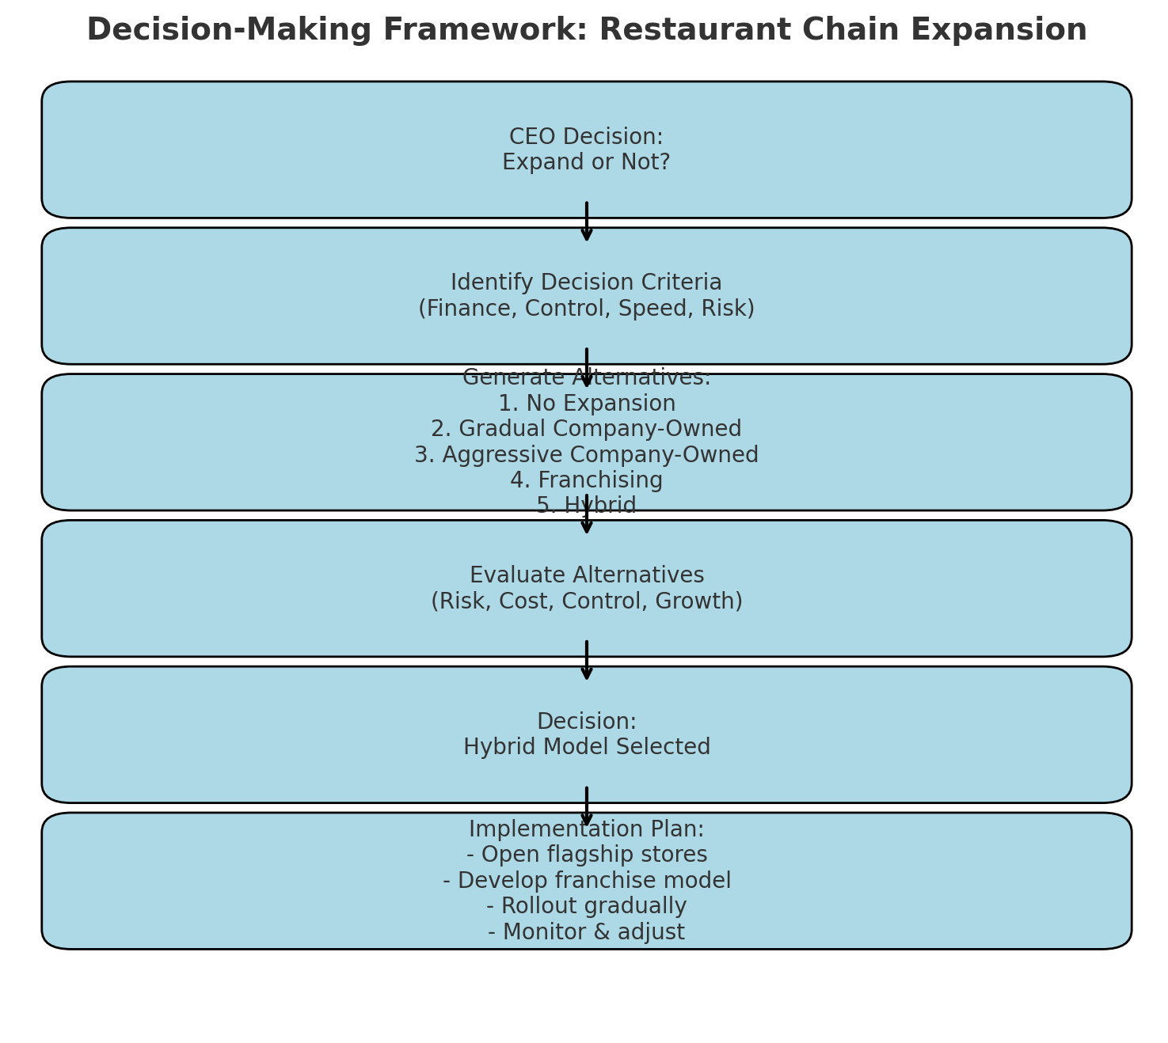

Slide 19

Simon's Model Application: Intelligence Phase:
Market research reveals growing demand for the cuisine type
Financial analysis shows strong cash flow but limited capital for rapid expansion
Competitive analysis identifies both opportunities and threats
Internal assessment reveals operational strengths and weaknesses

Slide 20

Design Phase:
Alternative 1: Gradual company-owned expansion (2-3 stores/year)
Alternative 2: Aggressive franchising model (10-15 stores/year)
Alternative 3: Strategic partnership with established restaurant group
Alternative 4: Status quo with regional focus

Slide 21

Choice Phase:
Evaluation criteria: Financial returns, risk level, control retention, growth speed
Decision matrix analysis weighing each alternative
Selection of franchising model with selective company-owned flagship stores

Slide 22
Implementation Phase:
Development of franchise operations manual
Legal framework establishment
Franchisee recruitment and training program
Performance monitoring systems

Slide 23

Group Decision-Making Elements:
Board of directors' involvement in strategic choice
Management team input on operational feasibility
Customer focus groups for market validation
Potential for groupthink if board is too cohesive

Slide 24

Case Study 2: IT System Upgrade (Semi-Structured Decision)
Background: A mid-size manufacturing company needs to replace its aging ERP system.
The IT director must choose between three vendor proposals while balancing cost, functionality, and implementation timeline.

Slide 25

Decision Type Analysis:
Semi-structured because there are established evaluation criteria for IT systems
However, each implementation is unique with company-specific requirements
Combines quantitative factors (cost, performance) with qualitative factors (vendor support, user experience)

Slide 26
Simon's Model Application:
Intelligence Phase:
Current system performance assessment
User needs analysis across departments
Budget constraints identification
Timeline requirements from business planning

Slide 27

Design Phase:
RFP process with three qualified vendors
Evaluation criteria development (cost 30%, functionality 40%, implementation 20%, support 10%)
Site visits to reference customers
Proof of concept testing

Slide 28

Choice Phase:
Scoring matrix for each vendor proposal
Cost-benefit analysis over 5-year period
Risk assessment for each option
Final selection based on weighted criteria

Slide 29

Implementation Phase:
Project plan with milestones and resource allocation
Change management program for users
Training schedule development
Go-live support and monitoring

Slide 30

Behavioral Considerations:
IT staff may have vendor preferences based on technical familiarity
Department heads may lobby for features benefiting their areas
Need to manage resistance to change from current system users

Slide 31

Case Study 3: Emergency Response - Product Recall (Unstructured Decision)
Background: A consumer products company discovers a potential safety issue with one of its best-selling items.
The quality control manager must decide whether to issue a voluntary recall, despite uncertain risk levels and significant financial implications.

Slide 32
Decision Characteristics:
Unstructured due to novel situation and high uncertainty
Time pressure prevents extensive analysis
High stakes with public safety and company reputation at risk
Limited precedent for exact situation

Slide 33
Simon's Model Application:
Intelligence Phase (Compressed):
Rapid assessment of safety risk data
Legal consultation on liability exposure
Review of similar industry incidents
Stakeholder impact analysis (customers, retailers, shareholders)

Slide 34

Design Phase (Accelerated):
Option 1: Full immediate recall with public announcement
Option 2: Quiet recall through retailers without publicity
Option 3: Enhanced monitoring with recall if issues confirmed
Option 4: Continue sales with additional warning labels

Slide 35
Choice Phase:
Risk assessment matrix (safety risk vs. business impact)
Ethical framework application (stakeholder welfare priority)
Decision under time pressure with incomplete information
Selection of full immediate recall prioritizing safety

Slide 36

Implementation Phase:
Crisis communication plan activation
Retail partner coordination for product removal
Customer notification and refund process
Media relations and stakeholder communication

Slide 37

Group Decision-Making Dynamics:
Crisis team with representatives from legal, marketing, operations, and quality
Potential for conflict between safety-first and business-protection perspectives
Need for rapid consensus despite high stakes
CEO involvement for final authorization

Slide 38


Key Learning Points from Case Studies

Slide 39

Decision Type Recognition:
Understanding whether a decision is structured, semi-structured, or unstructured helps determine appropriate tools and processes.

Slide 40

2. Simon's Model Flexibility:
The model can be compressed for urgent decisions or expanded for strategic choices, but all phases should be considered.

Slide 41

3. Group Composition Matters:
Different decisions benefit from different group compositions and decision-making processes.

Slide 42

4. Behavioral Awareness:
Recognizing potential biases and group dynamics helps improve decision quality.

Slide 43

5. Context Sensitivity:
The same framework applied in different contexts (routine operations vs. crisis) requires adaptation.

Slide 44
6. Implementation Focus:
Even excellent decisions fail without proper implementation planning and execution.

Slide 45

Practical Application Guidelines
When to Use Each Decision Type Approach

Slide 46
Structured Decisions:
Develop standard operating procedures
Use automated decision systems where possible
Focus on efficiency and consistency
Regular review and updating of criteria

Slide 47
Semi-Structured Decisions:
Combine analytical tools with expert judgment
Use decision support systems
Document rationale for future reference
Balance quantitative and qualitative factors

Slide 48
Unstructured Decisions:
Emphasize creativity and innovation
Use scenario planning and simulation
Involve diverse perspectives
Accept higher uncertainty and risk

Slide 49

Optimizing Simon's Model
Intelligence Phase: Invest time in problem definition - a well-defined problem is half-solved
Design Phase: Generate multiple alternatives before evaluating any
Choice Phase: Use appropriate decision tools (cost-benefit analysis, decision trees, etc.)
Implementation Phase: Plan for monitoring and adjustment from the beginning

Slide 50

Managing Group Decision-Making:
Best Practices:
Clearly define roles and decision authority
Encourage constructive dissent and devil's advocacy
Use structured techniques (nominal group technique, Delphi method)
Separate idea generation from evaluation
Consider anonymous input methods for sensitive topics

